Slide 1
INTRODUCTION TO MACHINE LEARNING
May 18, 2020

Slide 2


Who am I?
Data Science Platform for model-driven businesses
Okeefe Niemann
Field Engineer | Domino
Notes:
Going to include learnings from many of our customers. Benefit of working with leading data science organizations

Slide 3
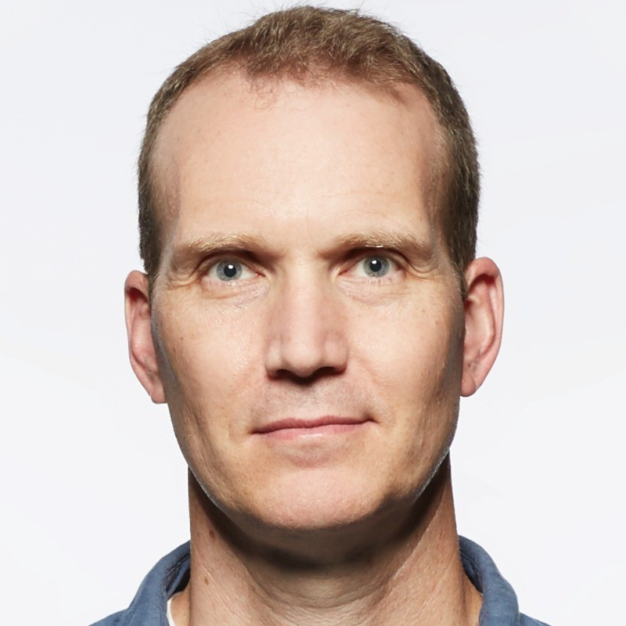
Teaching Assistants
Josh Poduska
Chief Field Data Scientist | Domino

Slide 4

Agenda
TITLE | DURATION
ACCESS DOMINO | 10 MIN
MOTIVATION | 15 MIN
WORKSHOP & HANDS-ON | 140 MIN
Q&A | 15 MIN
Notes:
First section — going to spend time motivating the problem. important. This is actually a big deal, want to spend some time on why it’s such a big deal.
Then we’ll get more concrete.
And going to do some exercises.

Slide 5
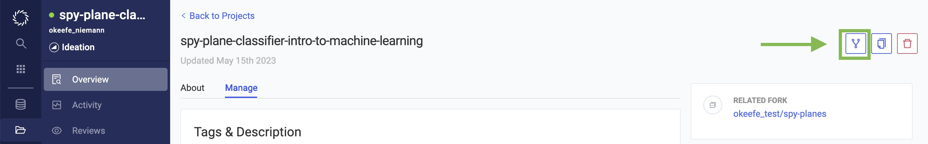
Access Materials
Create an account at lmtrain16408.cs.domino.tech
Navigate to https://lmtrain16408.cs.domino.tech/u/okeefe_niemann/spy-plane-classifier-intro-to-machine-learning/overview
Fork the project
Notes:
*review activity

Slide 6
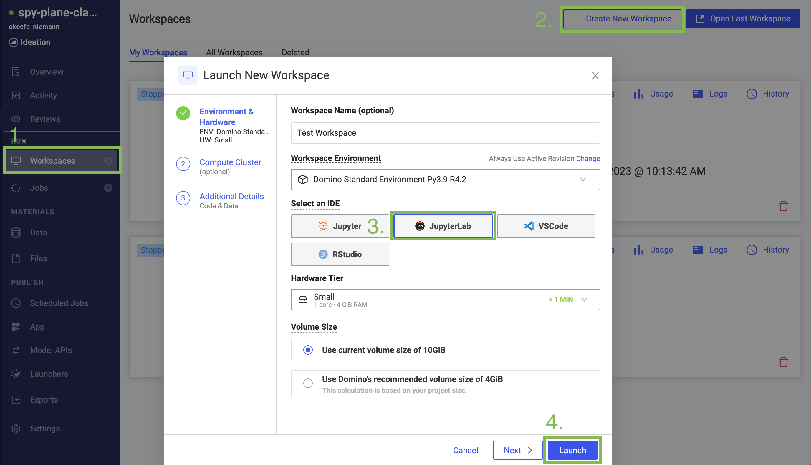
Create Workspace
Navigate to “Workspace” Tab
Select “Create New Workspace”
3. Select “JupyterLab”
4. Click “Launch”
Notes:
*review activity

Slide 7
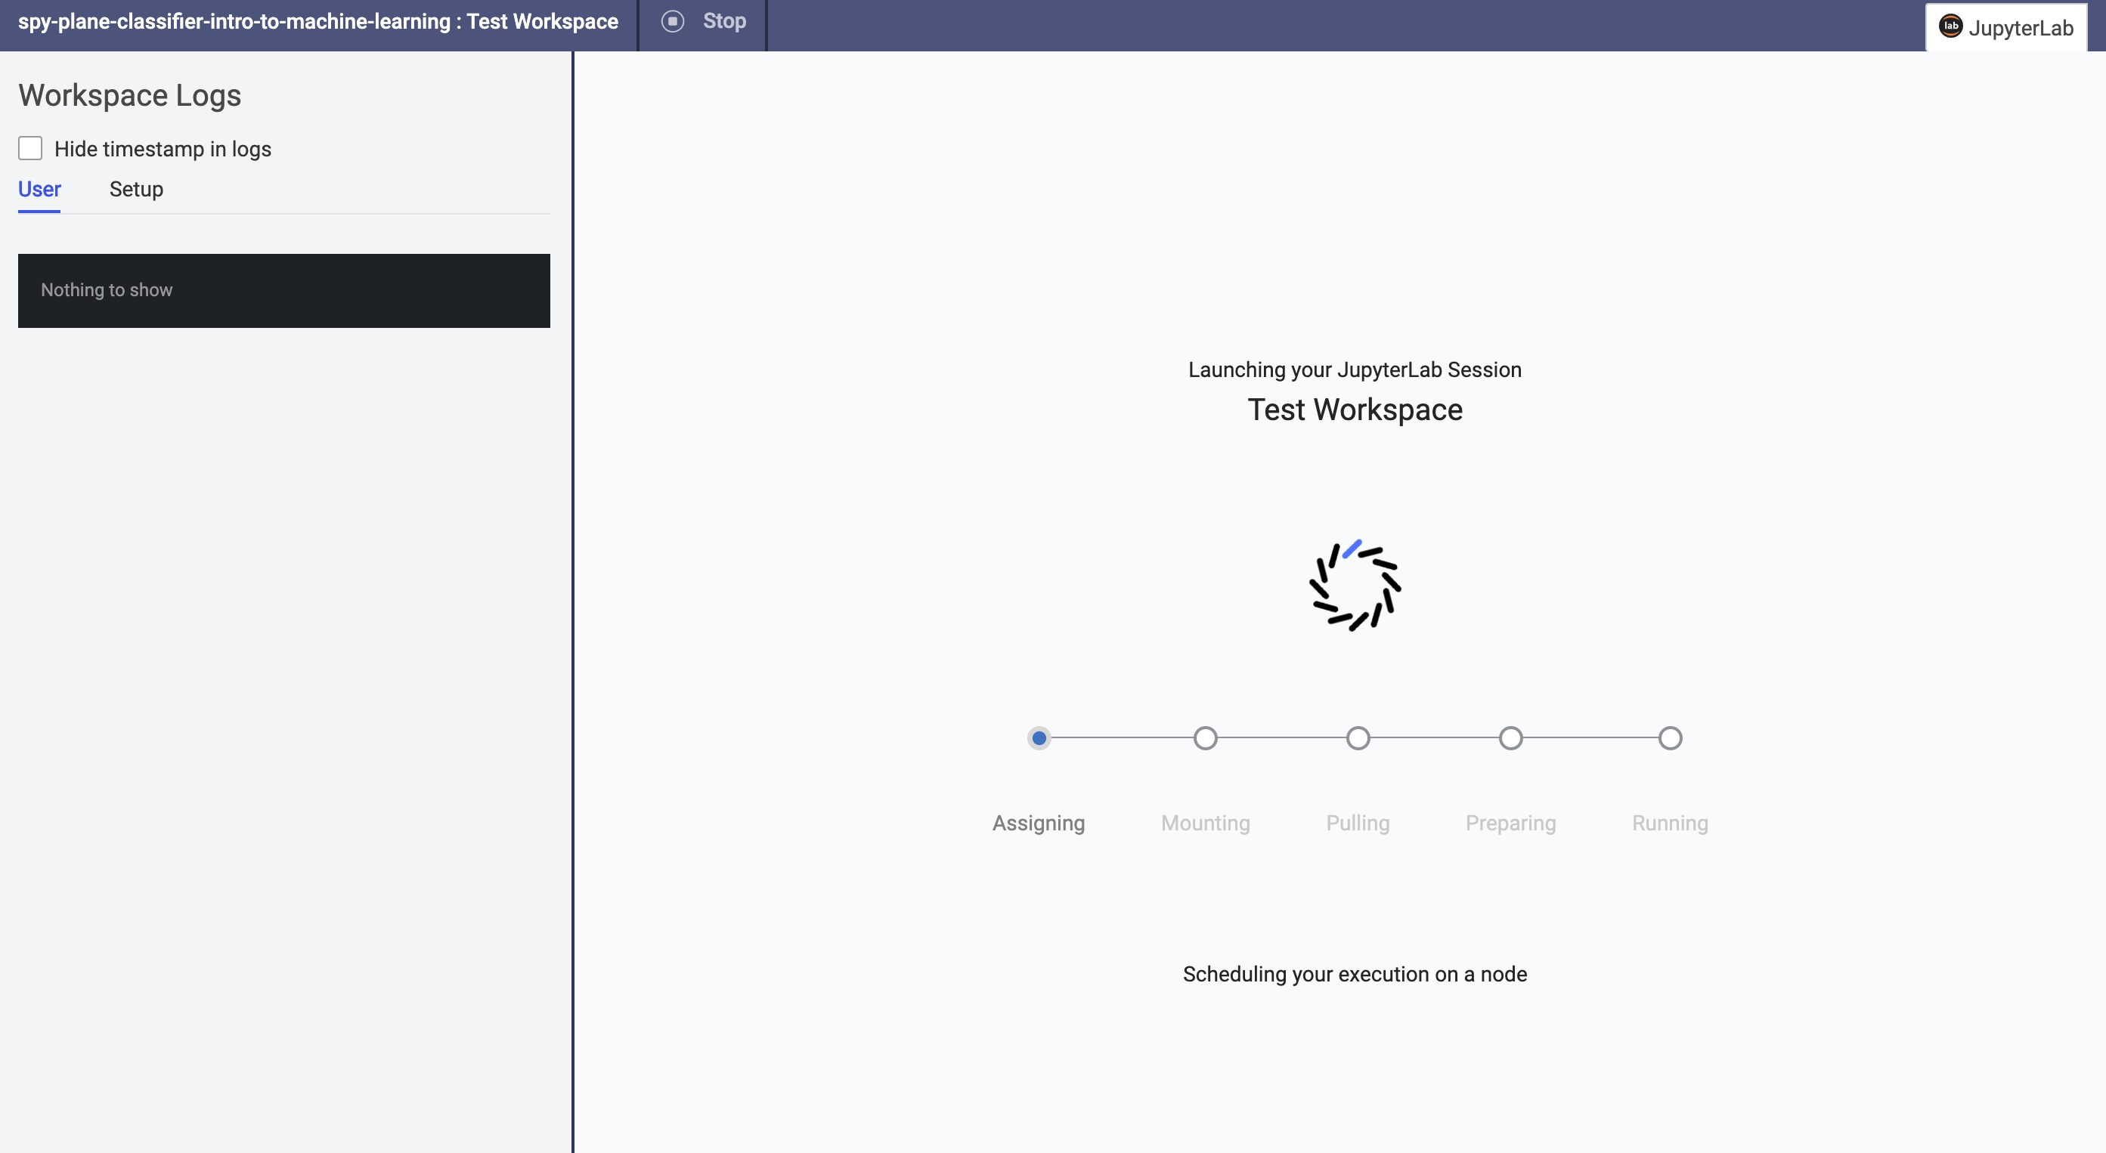
Wait to Launch
Notes:
*review activity

Slide 8
12
Companies that don’t run their business on models face an existential threat
The implications of not becoming a Model-Driven business are existential.
Notes:
Threat is the other companies that are leveraging DS across their org

Slide 9
1
2
Breakthroughs that open new revenue streams, expand into new markets, create new products.
Operational efficiencies that compound through constant incremental improvement.

Slide 10
Many organizations treat data science as a technical practice —
instead of an organizational capability
Notes:
Going to get more concrete and do some fun hands-on modeling in a bit, but if you walk away (or close out of the Zoom) remembering only one thing, it should be this

Slide 11






How Model-Driven Organizations Operate
Data science leaders
Risk and compliance leaders
Validation & Review
Model Development
Model Delivery/
Deployment
Business stakeholders and IT system owners
Data Scientists
Monitoring & Feedback
Business leaders &
Data science leaders
CIOs and IT leaders
Notes:
Tight orchestration across many stakeholders in iterative lifecycle
You have an awesome data science team, pitch to them the same way you might pitch to your Product team
Building empathy, not about finger pointing
Technology can help reduce the friction of this cycle

Slide 13
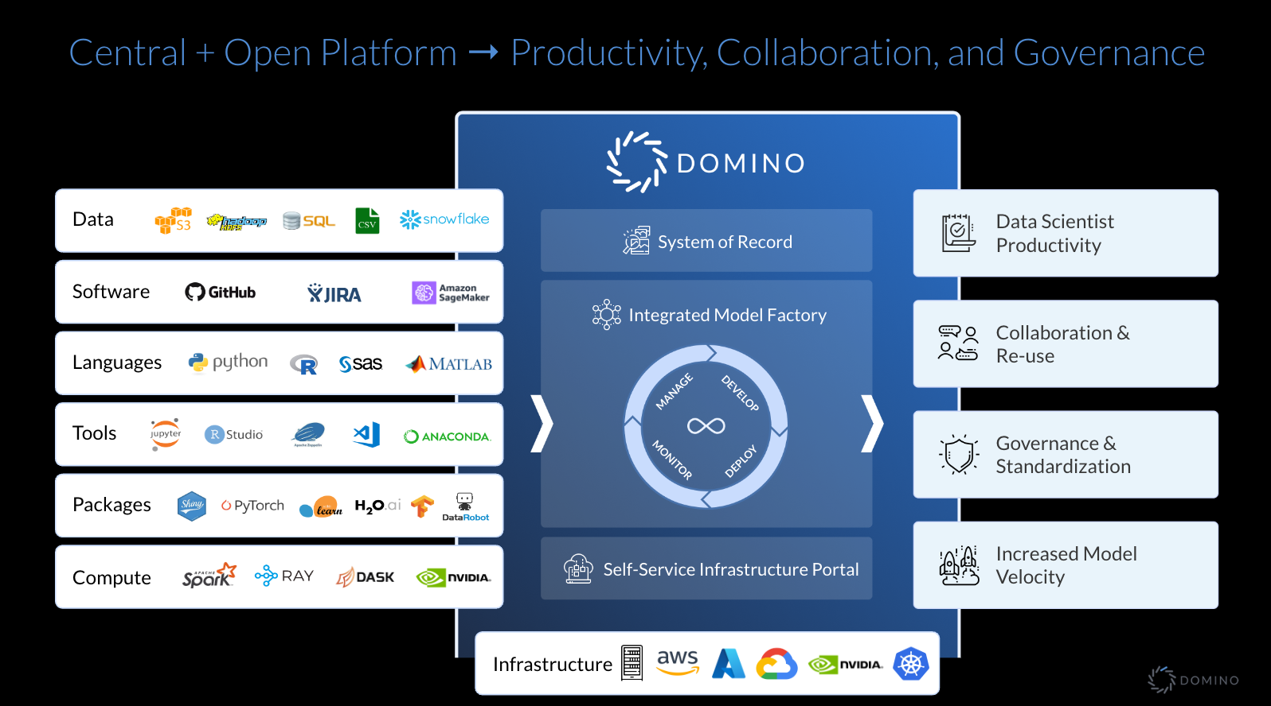

Slide 14
How Model-Driven Organizations Operate
Data science leaders
Risk and compliance leaders
Validation & Review
Model Development
Model Delivery/
Deployment
Business stakeholders and IT system owners
Data Scientists
Monitoring & Feedback
Business leaders &
Data science leaders
CIOs and IT leaders

Slide 15
Pick the right problem to solve
Notes:
I think I’ve talked enough about how important models can be, but you want to make sure you are building the right models

Slide 16
Project Prioritization
Calculate Value ($100k, $1M, $10M, etc.)
Estimate Effort (hour, day, week, year, etc.)
Forecast Risks
Barriers to adoption
Potential consequences of errors or performance degradation
“Product management” principles apply to data science projects just as much as engineering projects
High
VALUE
Low
EFFORT
Low
High
Risk
Notes:
Order of magnitude estimates
Value: how much improvement is realistic?

Slide 17
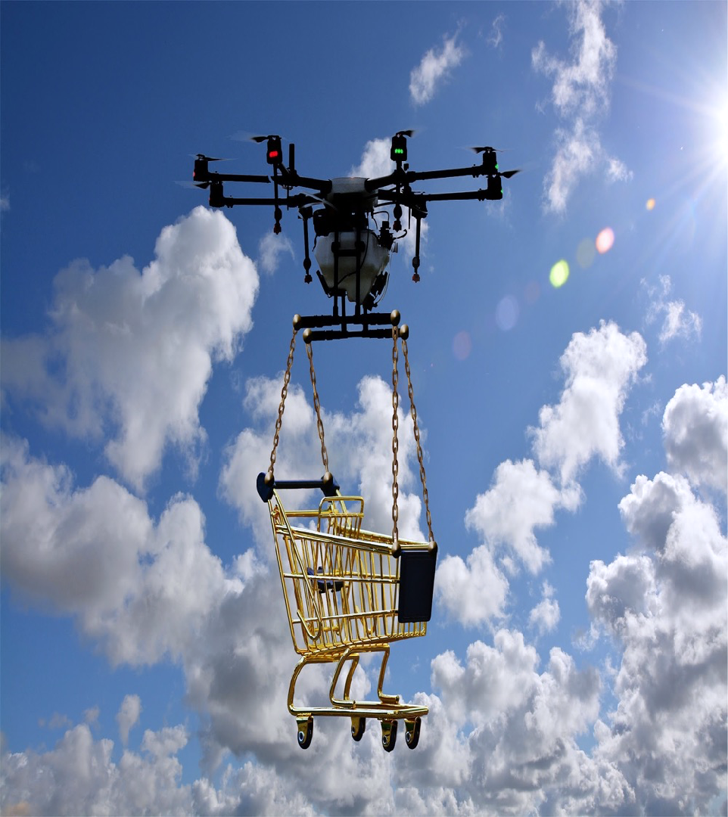


Other Considerations
Data Availability
Can use current data limitations to define future data engineering needs
Prior Art Review
Review state of the art — internally and externally
Model Delivery Plan
How will this model be deployed?
Proceed incrementally to get feedback from real usage
Success Measures
How will we know if this worked?
Frame in terms of business KPIs
Notes:
Can use current DS data limitations to define future data engineering needs

Slide 18
The Model Myth
The misconception that because models involve code and data, they should be treated the same as software or data

Slide 19
Traditional Programming
Data
Output
Program
Machine Learning
Data
Program
Output
https://www.seas.upenn.edu/~cis519/fall2017/lectures/01_introduction.pdf

Slide 20





Model Development
Evaluate Model
Share & Collaborate
Get Data
Build Model
Prepare Data

Slide 21
How Do I Get Data?
GET DATA
Read in files, images, text, etc.
Connect to database
Use an API
Web scraping
…

Slide 22
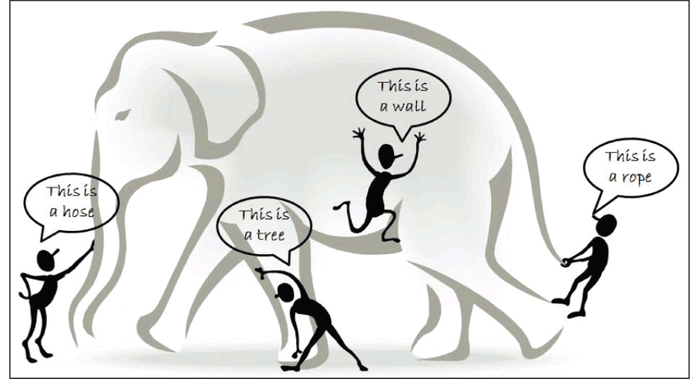
Get LOTS OF Data!
GET DATA
https://www.researchgate.net/publication/301325506_Analysis_of_Data_Mining_Techniques_and_its_Applications
Notes:
It’s really important to make sure you have data that covers the features needed to classify or predict whatever it is that you’re hoping to find. For example, if we were hoping to classify images of elephants but only had pictures of the tail, we wouldn’t be able to do this effectively and would need to pull in images that cover the entirety of the elephant. Many times, this requires pulling in data from more than one source and figuring out how to connect these together.

Slide 23
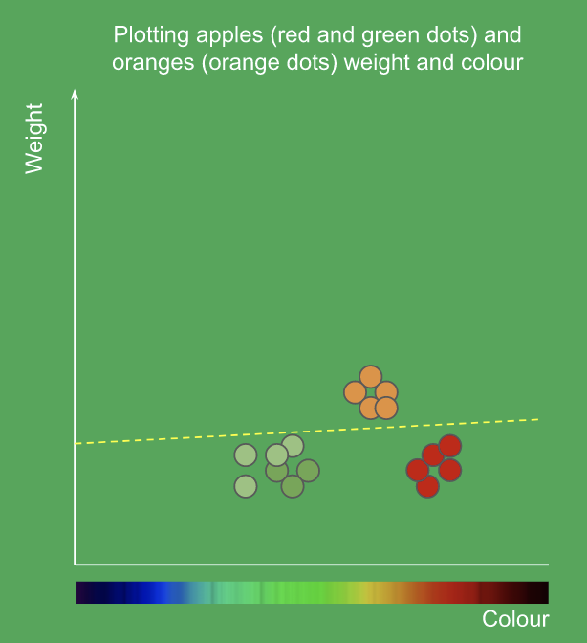
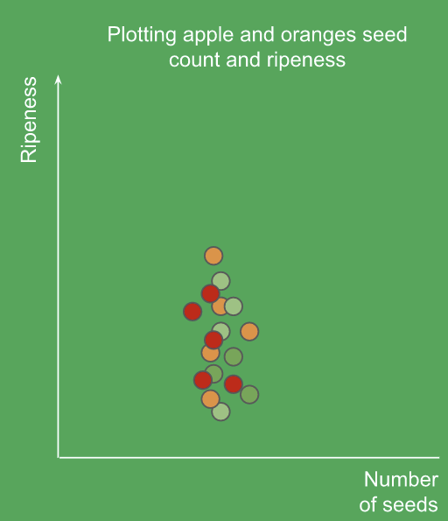
Get USEFUL Data!
GET DATA
https://goo.gl/5Wd2vy
Notes:
It’s really important to make sure you have data that covers the features needed to classify or predict whatever it is that you’re hoping to find. For example, if we were hoping to classify images of elephants but only had pictures of the tail, we wouldn’t be able to do this effectively and would need to pull in images that cover the entirety of the elephant. Many times, this requires pulling in data from more than one source and figuring out how to connect these together.

Slide 24
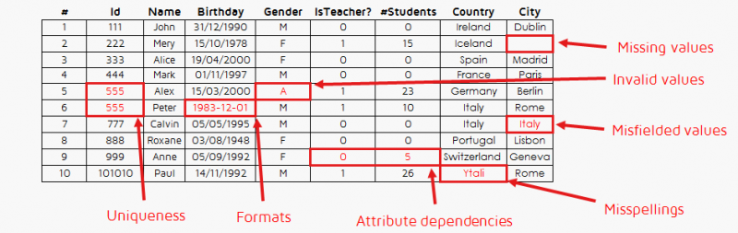
Inspect the Data
GET DATA
Visualize data
Look at descriptive statistics
Look for misfielded values
Notes:
It’s really important to make sure you have data that covers the features needed to classify or predict whatever it is that you’re hoping to find. For example, if we were hoping to classify images of elephants but only had pictures of the tail, we wouldn’t be able to do this effectively and would need to pull in images that cover the entirety of the elephant. Many times, this requires pulling in data from more than one source and figuring out how to connect these together.

Slide 25
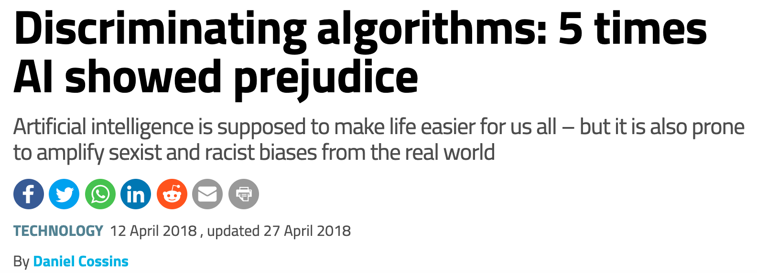
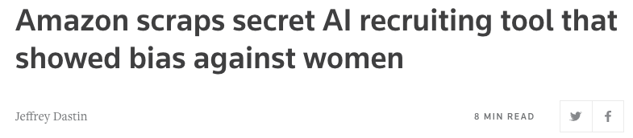
Data Bias
GET DATA
https://www.newscientist.com/article/2166207-discriminating-algorithms-5-times-ai-showed-prejudice/
Notes:
It’s also really important to make sure you understand your data and that you’ve cleaned this properly. For example, you may be looking at airport delays with one of your columns being timestamps from the flights - it would be important to extract the hour of the day for training instead of the entire date time. Another very important thing to keep in mind is that if you feed in biased or skewed data then your algorithm is going to be biased. There are many news articles about, with one famous case being the algorithm widely used in the US to guide sentencing by predicting the likelihood of a criminal reoffending. According to the analysis, the system predicts that black defendants pose a higher risk of recidivism than they do, and the reverse for white defendants. There are also many other things to consider about how our data looks that we’ll cover later.

Slide 26
Model Development
Evaluate Model
Share & Collaborate
Get Data
Build Model
Prepare Data

Slide 27
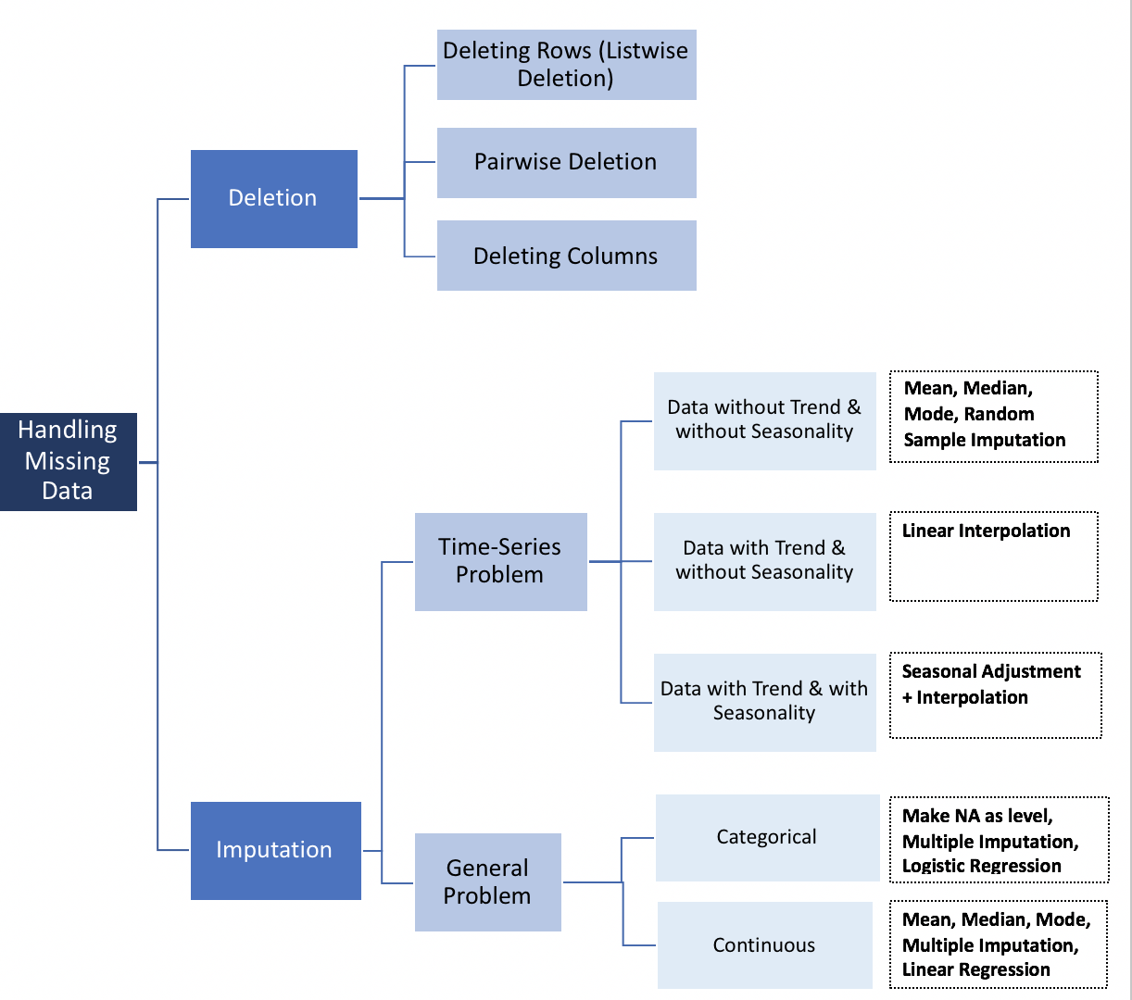
Missing Values
PREPARE
DATA
Are these missing at random?
Example: those with higher salaries may not report income on survey
Will removing these introduce bias?
https://towardsdatascience.com/how-to-handle-missing-data-8646b18db0d4
Notes:
Maybe the missing values are correlated with another attribute (people with high salaries don’t want to reveal their income on surveys)

Slide 28
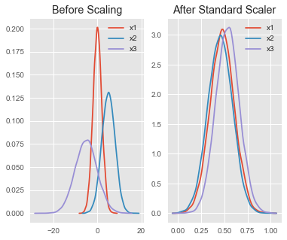
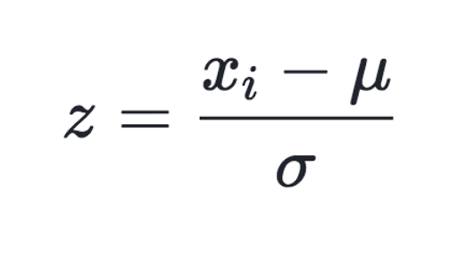
Scaling
PREPARE
DATA
Compare features with different units or scales
Rescales data to have a mean of 0 and a standard deviation of 1
Changing range of data
https://becominghuman.ai/demystifying-feature-scaling-baff53e9b3fd
Notes:
The difference is that, in scaling, you’re changing the range of your data (while in normalization you’re changing the shape of the distribution of your data). This assumes your data is normally distributed within each feature

Slide 29
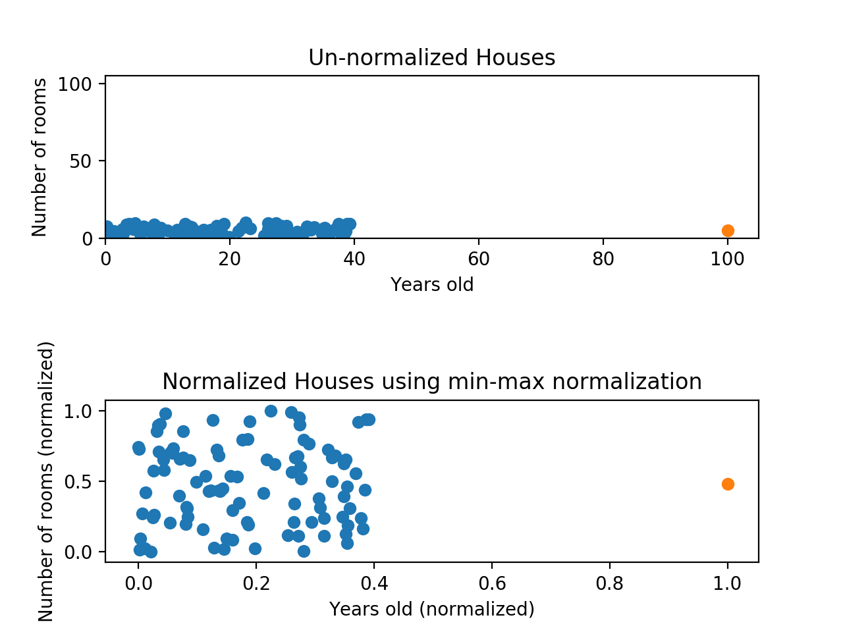
Scaling
PREPARE
DATA
Scaling fixed the “compression” on y-axis but x-axis is still problematic
Y-axis would dominate when comparing
Notes:
Min-max normalization has one fairly significant downside: it does not handle outliers very well. For example, if you have 99 values between 0 and 40, and one value is 100, then the 99 values will all be transformed to a value between 0 and 0.4. That data is just as squished as before! Take a look at the image below to see an example of this.
Normalizing fixed the squishing problem on the y-axis, but the x-axis is still problematic. Now if we were to compare these points, the y-axis would dominate; the y-axis can differ by 1, but the x-axis can only differ by 0.4.

Slide 30
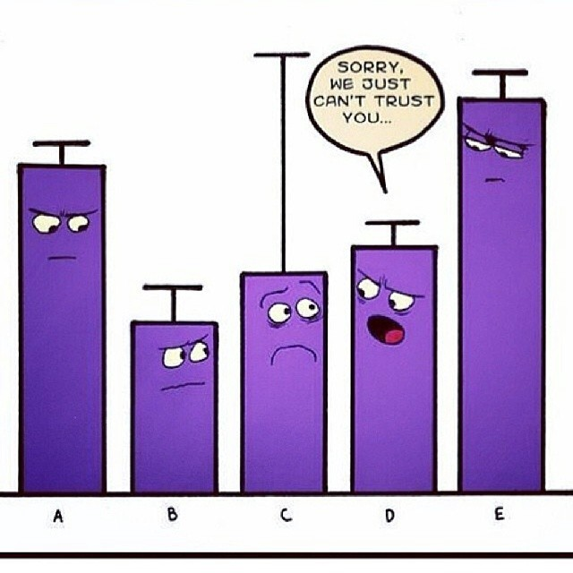
Outliers
PREPARE
DATA
Identify statistically
Consider the cause - sampling, experimental, or data entry errors?
Methods to correct for outliers:
Delete
Impute - replace with mean, median, or most frequent
Transform or bin data
https://medium.com/datadriveninvestor/unboxing-outliers-in-machine-learning-d43fe40d88a6

Slide 31
Feature Engineering
PREPARE
DATA
Using domain knowledge to create features that make algorithms work
Can use bucketing (i.e. for age), combining (i.e. for latitude and longitude), extracting (i.e. hour of day)
Remove features that are just creating noise or are not improving models but increasing run time
Notes:
Uses domain knowledge - say you have time stamps for predicting flight delays, you might want to consider just the hour of the day initially
Bucketing (age), combining (latitude and longitude)
Extra features can decrease performance because they may “confuse” the model by giving it irrelevant data that prevents it from learning the actual relationships.
The random forest performs implicit feature selection because it splits nodes on the most important variables, but other machine learning models do not.

Slide 32

Summary
PREPARE
DATA
Outliers
Missing values
Scaling
Feature Engineering
Main Takeaway
Data cleaning is the key step to making machine learning algorithms work

Slide 33
HANDS-ON: DATA EXPLORATION & PREPARATION

Slide 34
Model Development
Evaluate Model
Share & Collaborate
Get Data
Build Model
Prepare Data

Slide 35
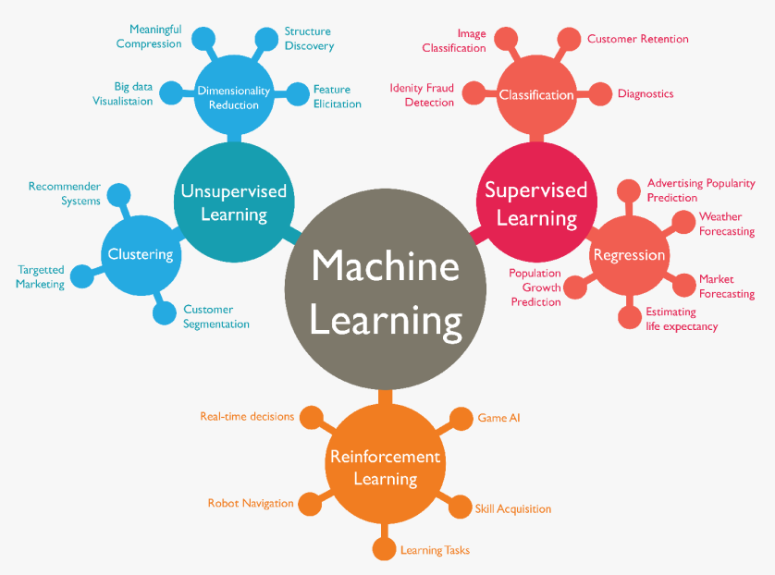
Types of Models
BUILD
MODEL
Supervised vs. Unsupervised
Classification vs. Regression
https://medium.com/forsk-labs/machine-learning-for-beginners-71c391f327ed
Notes:
This chart shows the main branches of machine learning, which are supervised and unsupervised learning, along with reinforcement learning. It also gives of further separation of both supervised learning and unsupervised learning and some examples what can fall under these categories such as compression for dimensionality reduction, diagnostics for classification, or weather forecasting for regression.

Slide 36
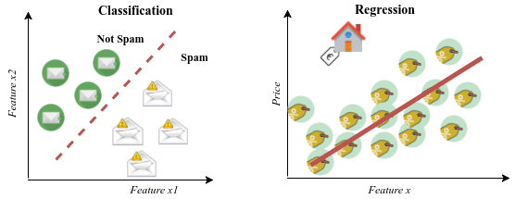
Supervised Learning
BUILD
MODEL
Uses Labeled Data to predict future outcomes based on past performance
https://www.researchgate.net/publication/319093376_DEEP_GENERATIVE_MODELS_FOR_SYNTHETIC_RETINAL_IMAGE_GENERATION
Notes:
Key is if you’re looking at your data set and one column is the answer

Slide 37
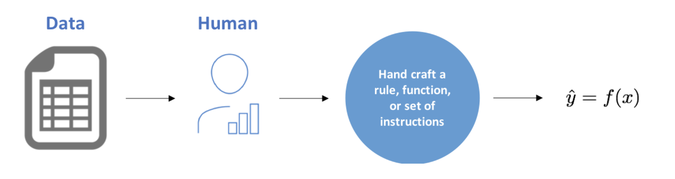
Human Modeling
BUILD
MODEL

Slide 38
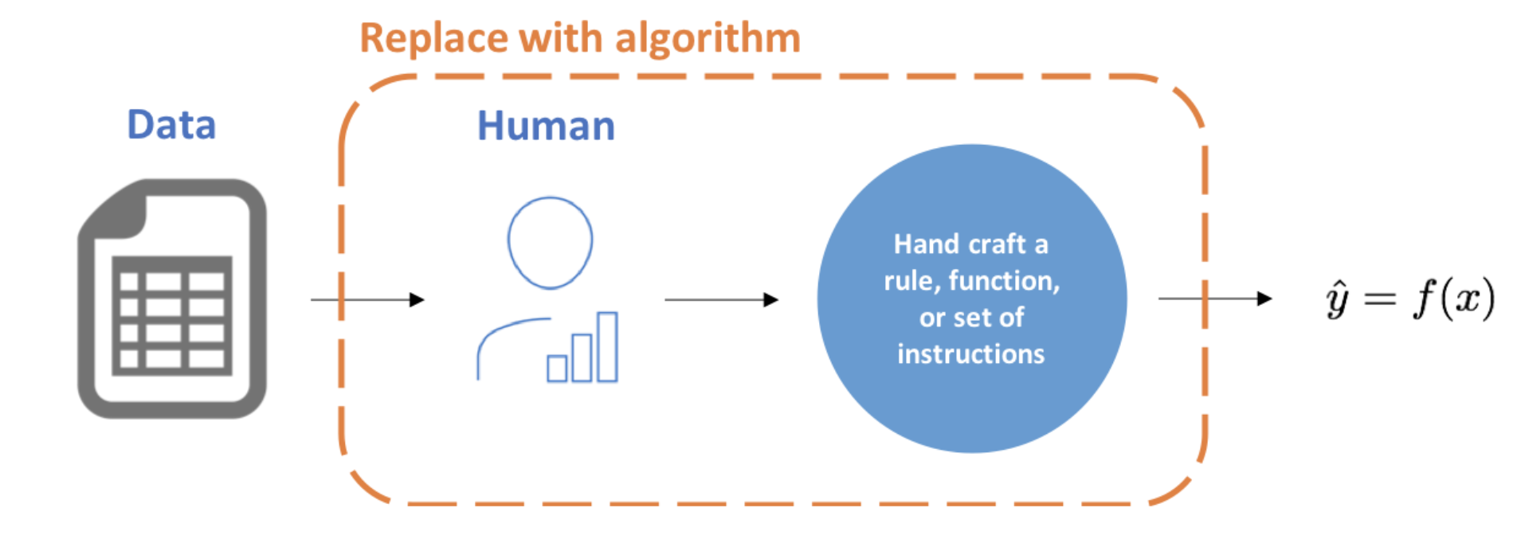
Machine Learning
BUILD
MODEL

Slide 39

Choosing an Algorithm
BUILD
MODEL
https://scikit-learn.org/stable/tutorial/machine_learning_map/index.html
Notes:
Now that we’ve talked about data we can talk about choosing a model. You’ve likely heard about models such as regression or maybe even xgboost or deep learning. And you’re likely wondering how to go about choosing a model. You’ll find charts such as this one from scikit learn, a very widely used Python package for machine learning. In general, you’ll be able to narrow down your selection based on whether you have labeled data and are predicting a category vs a quantity. However, this chart does not even begin to cover all of the models available or go into things like neural networks or reinforcement learning.
The main takeaway from this is that there is usually never one best algorithm, in fact in many cases you might test out a few different models to see which performs best.

Slide 40

Decision Trees
BUILD
MODEL
Model a set of sequential, hierarchical decisions that ultimately lead to some final classification
Data automatically divided to yes/no questions
The higher the branch, the broader the question
https://blog.statsbot.co/machine-learning-algorithms-183cc73197c
Notes:
-another slide on all the classification algorithms

Slide 41
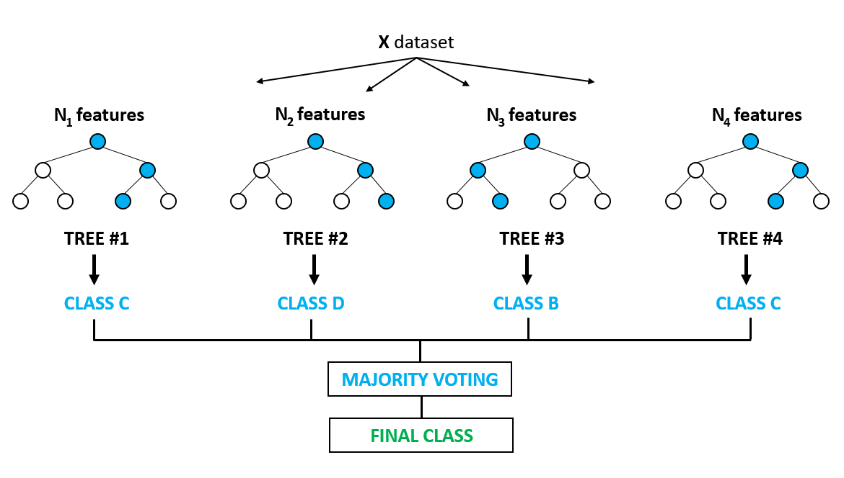
Random Forest Classifier
BUILD
MODEL
Less likely to overfit
Few statistical assumptions
Data does not need to be normally distributed
Relationships don’t need to be linear
https://medium.com/@ar.ingenious/applying-random-forest-classification-machine-learning-algorithm-from-scratch-with-real-24ff198a1c57
Notes:
Random Forest classifiers are a type of algorithm based on bagging, or bootstrap aggregating.They average multiple deep decision trees, trained on different parts of the same training set, with the goal of reducing the variance. Each decision tree in the forest considers a random subset of features when forming questions and only has access to a random set of the training data points. The random forest takes an average of all the individual decision tree estimates or the majority vote of the decision tree class.

Slide 42
HANDS-ON: BUILDING A MODEL

Slide 43
Model Development
Evaluate Model
Share & Collaborate
Get Data
Build Model
Prepare Data

Slide 44
Using Data to Test Model
EVALUATE
MODEL
Need a model that performs well on data it hasn’t seen before
Can split labeled data into test and train sets
Prevents overfitting

Slide 45
Real World Data
EVALUATE
MODEL
Increasing RMSE may not matter in the user experience
Business metrics and stakeholder impact are vital
What is the cost/impact of a false positive or false negative or incorrect prediction?

Slide 46


Accuracy
EVALUATE
MODEL
Out of 100 patients, 99 will be disease free
My model has an accuracy of 99% - this is good right??
This means that the model predicts every patients as disease free, therefore not useful at all

Slide 47
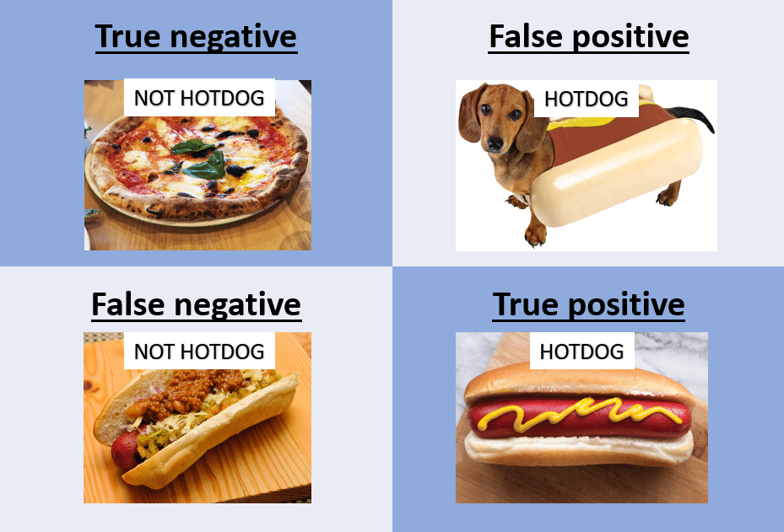
Confusion Matrix
EVALUATE
MODEL
 |  | Predicted Values
 |  | Negative | Positive
Actual Values | Negative | True Positives | False Positives
 | Positive | False Negatives | True Negatives
Notes:
A confusion matrix is a summary of prediction results on a classification problem. Here we can see the counts of how many correct and incorrect predictions were made for both the positive and negative classes (in our case the positive would be a surveillance or spy plane and negative would be the other, or normal, class).
The name stems from the fact that it makes it easy to see if the system is confusing two classes (i.e. commonly mislabeling one as another).
*explain how to remember the true pos and neg, fals pos and neg

Slide 48
Precision
EVALUATE
MODEL
 |  | Predicted Values
 |  | Negative | Positive
Actual Values | Negative | True Positives | False Positives
 | Positive | False Negatives | True Negatives
Precision =
TP
TP + FP
Notes:
Precision -

Slide 49
Recall
EVALUATE
MODEL
 |  | Predicted Values
 |  | Negative | Positive
Actual Values | Negative | True Positives | False Positives
 | Positive | False Negatives | True Negatives
Recall =
TP
TP + FN
Notes:
Precision -

Slide 50
F1 Score
EVALUATE
MODEL
Can be used to find optimal blend of precision and recall
Harmonic mean of the two
Used instead of average because it punishes extreme values
Useful when there is uneven class distribution
Perfect score = 1, total failure = 0
precision ⨉ recall
precision + recall
F1 Score = 2 ⨉
Notes:
Sometimes it’s more important to correctly classify your samples than getting all of them (high precision). Sometimes it’s more important to get all of them (high recall) than getting all of them correct. However, in cases where we want to find an optimal blend of precision and recall we can combine the two metrics using what is called the F1 score.
F1 Score might be a better measure to use if we need to seek a balance between Precision and Recall AND there is an uneven class distribution (large number of Actual Negatives).
Can measure this if only getting one thing and then explore

Slide 51
HANDS-ON: EVALUATING YOUR MODEL

Slide 52
Model Development
Evaluate Model
Share & Collaborate
Get Data
Build Model
Prepare Data

